Slide 1
Search in Games
Chen-Yu Wei

Slide 2
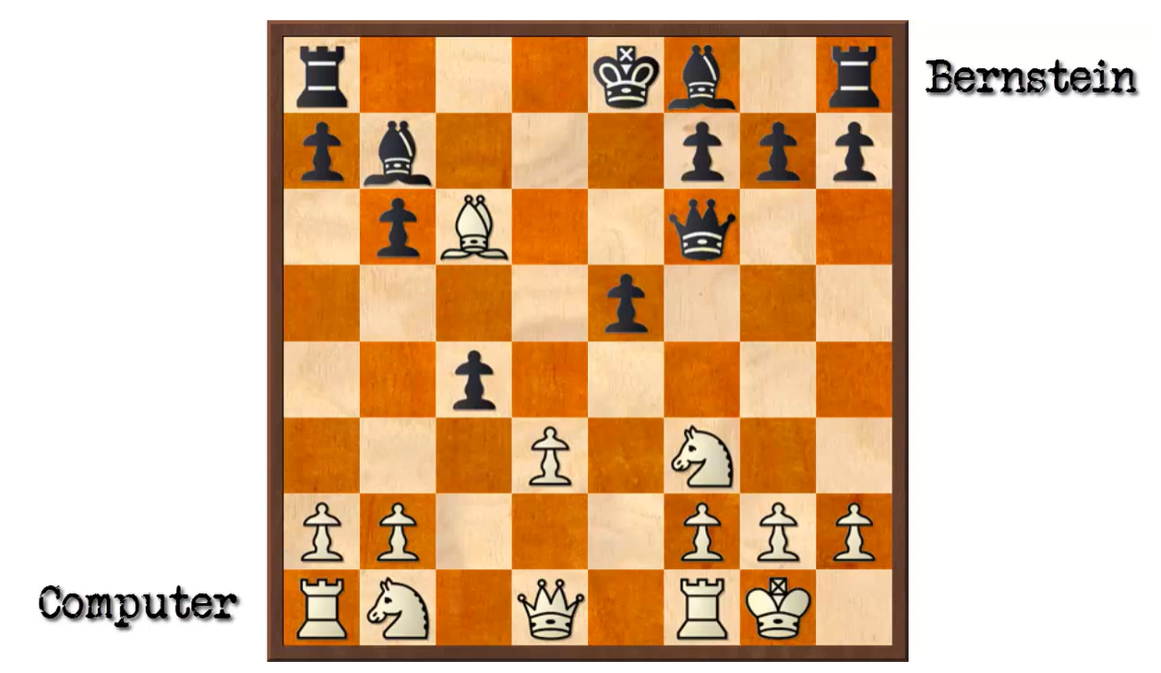
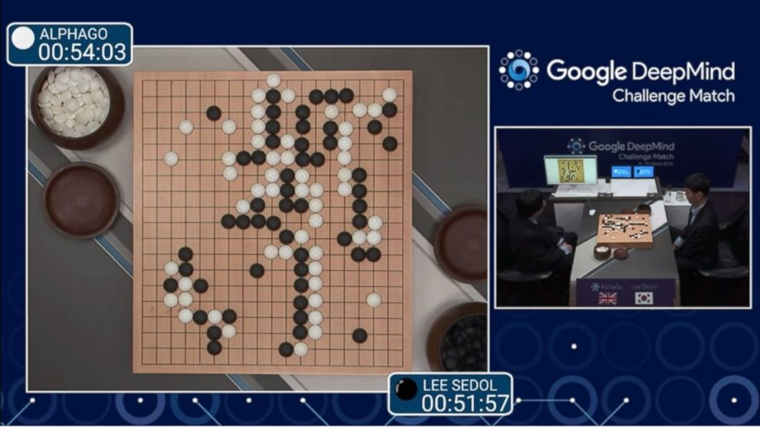
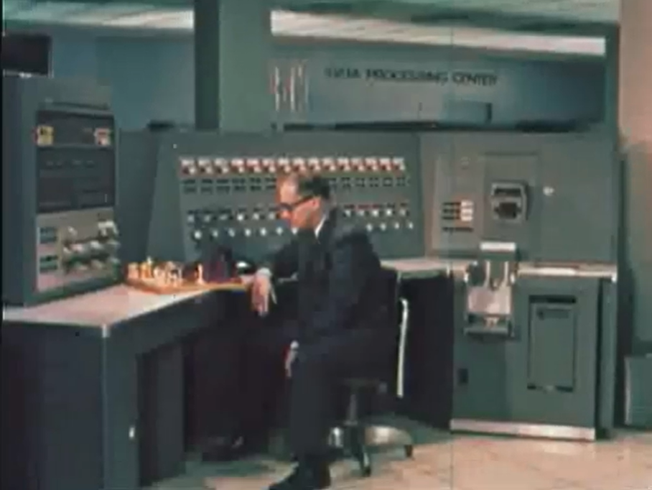

Slide 3
Turn-Based Two-Player Game
You choose one of the three bins. I choose a number from that bin. Your goal is to maximize the chosen number.
A
-50 50
B
1 3
C
15 -5
If I am
adversarial
random
benign/cooperative

Slide 4
Turn-Based Two-Player Zero-Sum Games
MAX
MIN
-50
50
1
3
15
-5
Terminal state values

Slide 5
Turn-Based Two-Player Zero-Sum Games
Minimax values for non-terminal states
MAX
1
MIN
-50
1
-5
-50
50
1
3
15
-5
Terminal state values

Slide 6
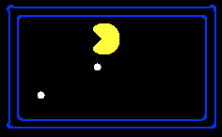

Example: PACMAN
-20
-8
…
-18
-5
…
-10
+4
-20
+8

Slide 7
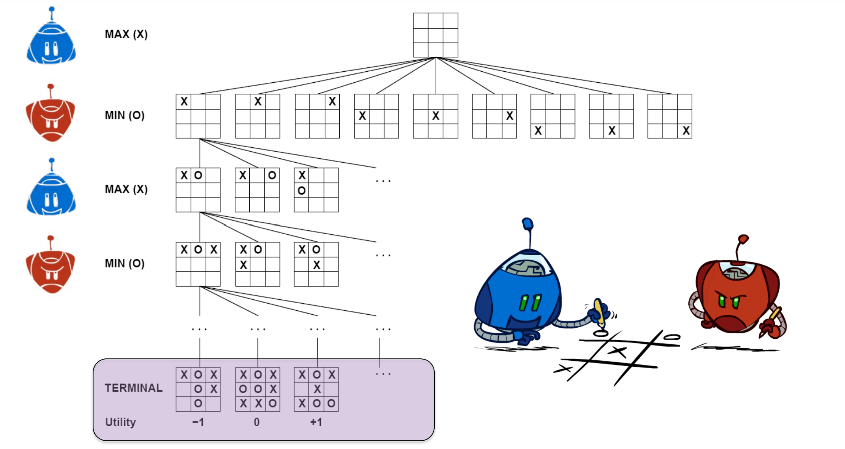
Example: Tic-Tac-Toe

Slide 8
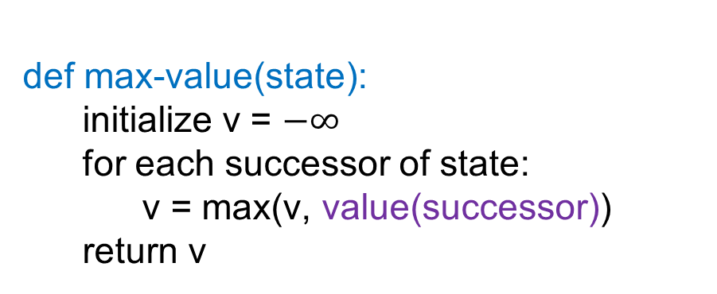
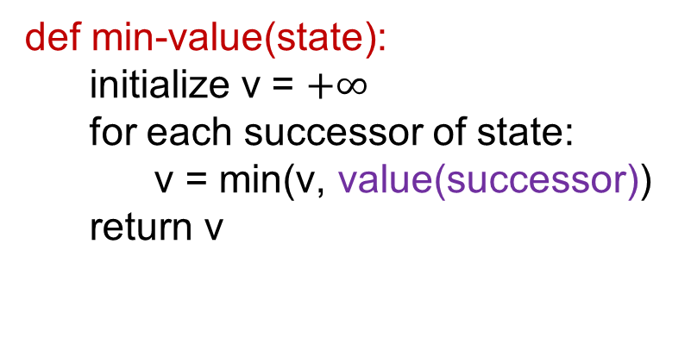
Calculating Minimax Values
def value(state):
if the state is a terminal state: return the state’s utility
if the next agent is MAX: return max-value(state)
if the next agent is MIN: return min-value(state)
def max-value(state):
initialize v = $−∞$
for each successor of state:
v = max(v, value(successor))
return v
def min-value(state):
initialize v = $+∞$
for each successor of state:
v = min(v, value(successor))
return v

Slide 9
The Minimax Policy
“Policy” is mapping from state to action.
MAX Player’s minimax policy
“Minimax policy” is the optimal policy against the most adversarial opponent.
MIN Player’s minimax policy
MAX
1
MIN
-50
1
-5
-50
50
1
3
15
-5

Slide 10
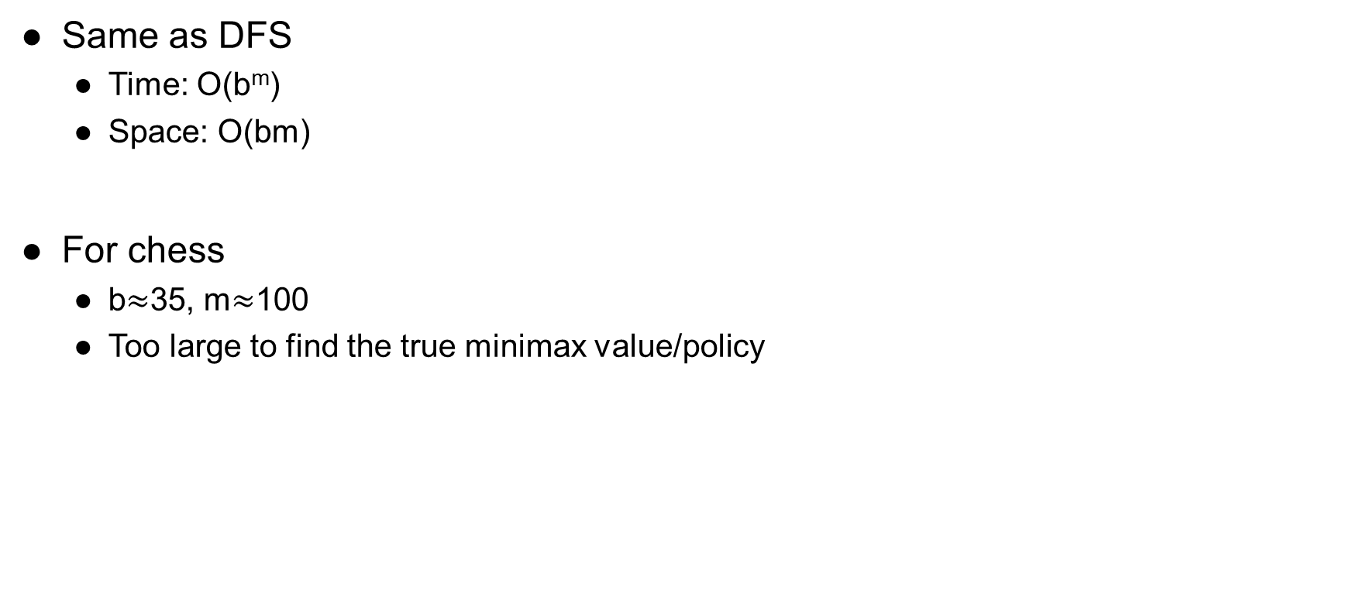
Time / Space Complexity
Same as DFS
Time: O(b^{m})
Space: O(bm)
For chess
b$≈$35, m$≈$100
Too large to find the true minimax value/policy

Slide 11
Alpha-Beta Pruning and Evaluation Functions

Slide 12
MAX
MIN
2
7
1
8

Slide 13
MAX
MIN
MAX
MIN

Slide 14
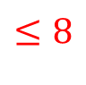
MAX
MIN
MAX
MIN
$$≤8$$
8

Slide 15
MAX
MIN
MAX
MIN
$$≤8$$
8
7

Slide 16
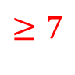
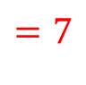
MAX
MIN
MAX
$$≥7$$
MIN
$$=7$$
8
7

Slide 17
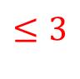
MAX
MIN
MAX
$$≥7$$
MIN
$$=7$$
$$≤3$$
8
7
3

Slide 18
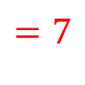
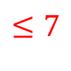
MAX
MIN
$$≤7$$
MAX
$$=7$$
MIN
$$=7$$
$$≤3$$
8
7
3

Slide 19
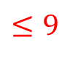
MAX
MIN
$$≤7$$
MAX
$$=7$$
MIN
$$=7$$
$$≤3$$
$$≤9$$
8
7
3
9

Slide 20
MAX
MIN
$$≤7$$
MAX
$$=7$$
MIN
$$=7$$
$$≤3$$
$$≤9$$
8
7
3
9
8

Slide 21
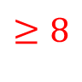
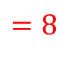
MAX
MIN
$$≤7$$
MAX
$$=7$$
$$≥8$$
MIN
$$=7$$
$$≤3$$
$$=8$$
8
7
3
9
8

Slide 22
MAX
MIN
$$≤7$$
MAX
$$=7$$
$$≥8$$
MIN
$$=7$$
$$≤3$$
$$=8$$
8
7
3
9
8

Slide 23
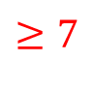

$$≥7$$
MAX
MIN
$$=7$$
MAX
$$=7$$
$$≥8$$
MIN
$$=7$$
$$≤3$$
$$=8$$
8
7
3
9
8

Slide 24
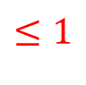
$$≥7$$
MAX
MIN
$$=7$$
MAX
$$=7$$
$$≥8$$
MIN
$$=7$$
$$≤3$$
$$=8$$
$$≤1$$
8
7
3
9
8
1

Slide 25
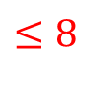
$$≥7$$
MAX
MIN
$$=7$$
MAX
$$=7$$
$$≥8$$
MIN
$$=7$$
$$≤3$$
$$=8$$
$$≤1$$
$$≤8$$
8
7
3
9
8
1
8

Slide 26
$$≥7$$
MAX
MIN
$$=7$$
MAX
$$=7$$
$$≥8$$
MIN
$$=7$$
$$≤3$$
$$=8$$
$$≤1$$
$$≤8$$
8
7
3
9
8
1
8
9

Slide 27
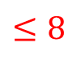


$$≥7$$
MAX
MIN
$$=7$$
$$≤8$$
MAX
$$=7$$
$$≥8$$
$$=8$$
MIN
$$=7$$
$$≤3$$
$$=8$$
$$≤1$$
$$=8$$
8
7
3
9
8
1
8
9

Slide 28
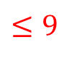
$$≥7$$
MAX
MIN
$$=7$$
$$≤8$$
MAX
$$=7$$
$$≥8$$
$$=8$$
MIN
$$=7$$
$$≤3$$
$$=8$$
$$≤1$$
$$=8$$
$$≤9$$
8
7
3
9
8
1
8
9
9

Slide 29
$$≥7$$
MAX
MIN
$$=7$$
$$≤8$$
MAX
$$=7$$
$$≥8$$
$$=8$$
MIN
$$=7$$
$$≤3$$
$$=8$$
$$≤1$$
$$=8$$
$$≤9$$
8
7
3
9
8
1
8
9
9
9

Slide 30
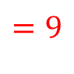
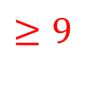
$$≥7$$
MAX
MIN
$$=7$$
$$≤8$$
MAX
$$=7$$
$$≥8$$
$$=8$$
$$≥9$$
MIN
$$=7$$
$$≤3$$
$$=8$$
$$≤1$$
$$=8$$
$$=9$$
8
7
3
9
8
1
8
9
9
9

Slide 31
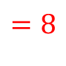
$$≥7$$
MAX
MIN
$$=7$$
$$=8$$
MAX
$$=7$$
$$≥8$$
$$=8$$
$$≥9$$
MIN
$$=7$$
$$≤3$$
$$=8$$
$$≤1$$
$$=8$$
$$=9$$
8
7
3
9
8
1
8
9
9
9

Slide 32
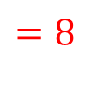
$$=8$$
MAX
MIN
$$=7$$
$$=8$$
MAX
$$=7$$
$$≥8$$
$$=8$$
$$≥9$$
MIN
$$=7$$
$$≤3$$
$$=8$$
$$≤1$$
$$=8$$
$$=9$$
8
7
3
9
8
1
8
9
9
9

Slide 33
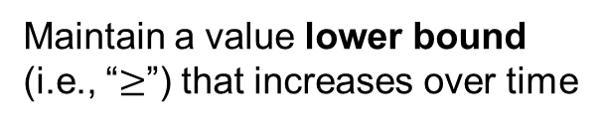
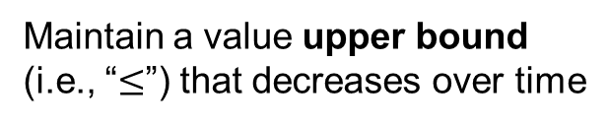
Alpha-Beta Pruning
Maintain a value lower bound (i.e., “$≥$”) that increases over time
MAX
MIN
Prune if there is inconsistency with ancestors
MAX
MIN
Maintain a value upper bound (i.e., “$≤$”) that decreases over time
n

Slide 34
Alpha-Beta Pruning
α: MAX’s best option on path to root
β: MIN’s best option on path to root
def max-value(state, α, β):
initialize v = -∞
for each successor of state:
v = max(v, value(successor, α, β))
if v ≥ β return v
α = max(α, v)
return v
def min-value(state , α, β):
initialize v = +∞
for each successor of state:
v = min(v, value(successor, α, β))
if v ≤ α return v
β = min(β, v)
return v

Slide 35
Alpha-Beta Pruning
The pruning has no effect on the minimax value computed for the root.
Child ordering affects the efficiency
If a MAX node finds a larger children value (or a MIN node finds a smaller children value) quicker, then more time can be saved.
With perfect ordering, the time complexity drops to O(b^{m/2})
Doubles solvable depth
Full search of, e.g., chess, is still hopeless

Slide 36
Resource Limits
In realistic games, cannot search to leaves
Solution: depth-limited search
Search only to a limited depth
At the last layer of the search, call the evaluation function (heuristic function)
Example
Suppose we have 100 seconds, can explore 10K nodes / sec
So can check 1M nodes per move
α-β reaches about depth 8 – decent chess program
Use iterative deepening for an anytime algorithm
4
max
-2
4
min
-1
-2
4
9
?
?
?
?

Slide 37
Evaluation Functions
Evaluation functions score non-terminal nodes in depth-limited search
E.g., weighted linear sum of features:
where f₁(s) = (num white queens – num black queens), etc.
Evaluation function can provide guidance to expand most promising nodes first (allowing alpha-beta pruning to prune more)

Slide 38
Expectimax

Slide 39
Two-Player Turn-Based Game
MAX
MIN
-50
1
-5
-50
50
1
3
15
-5

Slide 40
Two-Player Turn-Based Game
MAX
Chance
0
2
5
-50
50
1
3
15
-5

Slide 41
Expectimax Search
When do we have randomness?
Explicit randomness: rolling dice
Unpredictable opponents: the ghosts respond randomly
Actions can fail: when moving a robot, wheels might slip
Values now reflect average-case (expectimax) outcomes, not worst-case (minimax) outcomes.

Slide 42
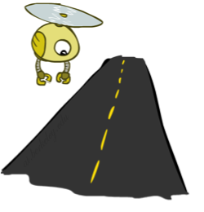
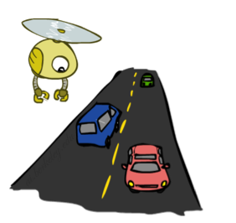
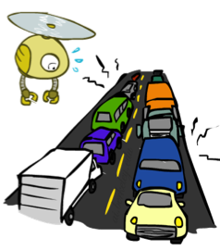
Reminder: Probabilities
Example: Traffic on freeway
Random variable: T = whether there’s traffic
Outcomes: T in {none, light, heavy}
Distribution: P(T=none) = 0.25, P(T=light) = 0.50, P(T=heavy) = 0.25
0.25
0.50
0.25
Time:
20 min
30 min
60 min
+
+
35 min
x
x
x
Probability:
0.25
0.50
0.25

Slide 43
Expectimax
def value(state):
if the state is a terminal state: return the state’s utility
if the next agent is MAX: return max-value(state)
if the next agent is EXP: return exp-value(state)
def max-value(state):
initialize v = -∞
for each successor of state:
v = max(v, value(successor))
return v
def exp-value(state):
initialize v = 0
for each successor of state:
p = probability(successor)
v += p * value(successor)
return v

Slide 44
Expectimax
3
12
9
2
4
6
15
6
0

Slide 45



Depth-Limited Expectimax
Estimate of true expectimax value (which might require a lot of work to compute)
400
300
…
…
492
362
…

Slide 46
What Probabilities to Use?
In expectimax search, we have a probabilistic model of how the opponent (or environment) will behave.
Model could be a simple uniform distribution (roll a die)
Model could be sophisticated and require a great deal of computation
We have a chance node for any outcome out of our control: opponent or environment
For now, assume each chance node magically comes along with probabilities that specify the distribution over its outcomes
You’ll get more ideas about how to produce such probabilistic models later in the semester when we talk about “learning from data”

Slide 47
Quiz: Informed Probabilities
Suppose you know that your opponent is running a depth-2 minimax, using the result 80% of the time, and moving randomly otherwise
Question: What tree search should you use?
Answer: Expectimax!
To figure out EACH chance node’s probabilities, you have to run a simulation of your opponent
This kind of thing gets very slow very quickly
Minimax search, on the other hand, has the nice property that it all collapses into one game tree
0.1 0.9

Slide 48
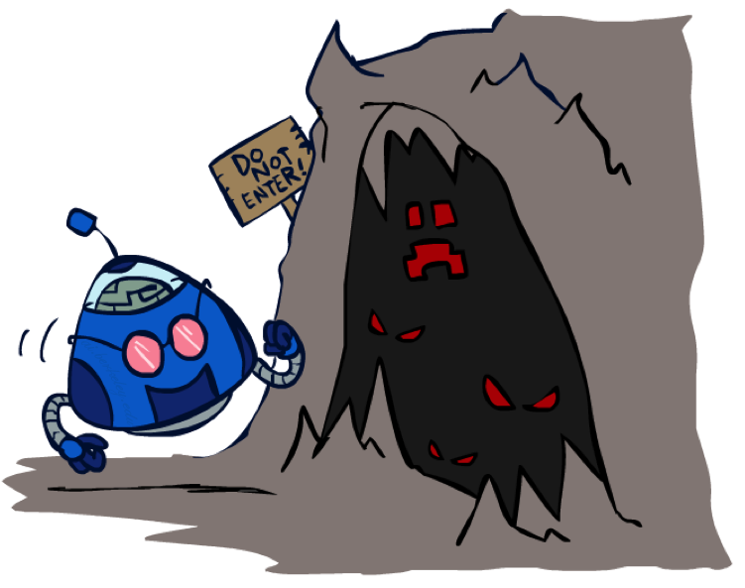
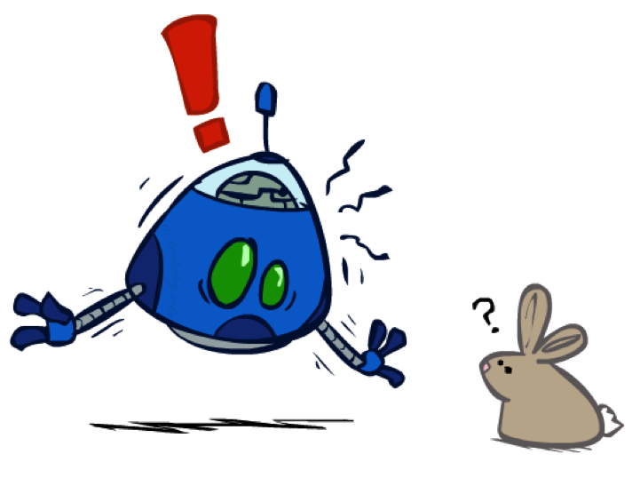
The Dangers of Optimism and Pessimism
Dangerous Optimism
Assuming chance when the world is adversarial
Dangerous Pessimism
Assuming the worst case when it’s not likely

Slide 49
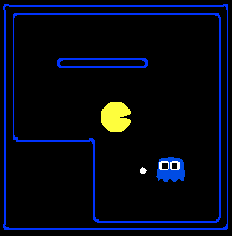
Assumptions vs. Reality
 | Adversarial Ghost | Random Ghost
Minimax Pacman | Won 5/5 Avg. Score: 483 | Won 5/5 Avg. Score: 493
Expectimax Pacman | Won 1/5 Avg. Score: -303 | Won 5/5 Avg. Score: 503
Results from playing 5 games
Pacman used depth 4 search with an eval function that avoids trouble Ghost used depth 2 search with an eval function that seeks Pacman

Slide 50

Random Ghost – Expectimax Pacman

Slide 51
Adversarial Ghost – Minimax Pacman

Slide 52
Adversarial Ghost – Expectimax Pacman

Slide 53
Random Ghost – Minimax Pacman

Slide 54
Monte-Carlo Tree Search

Slide 55
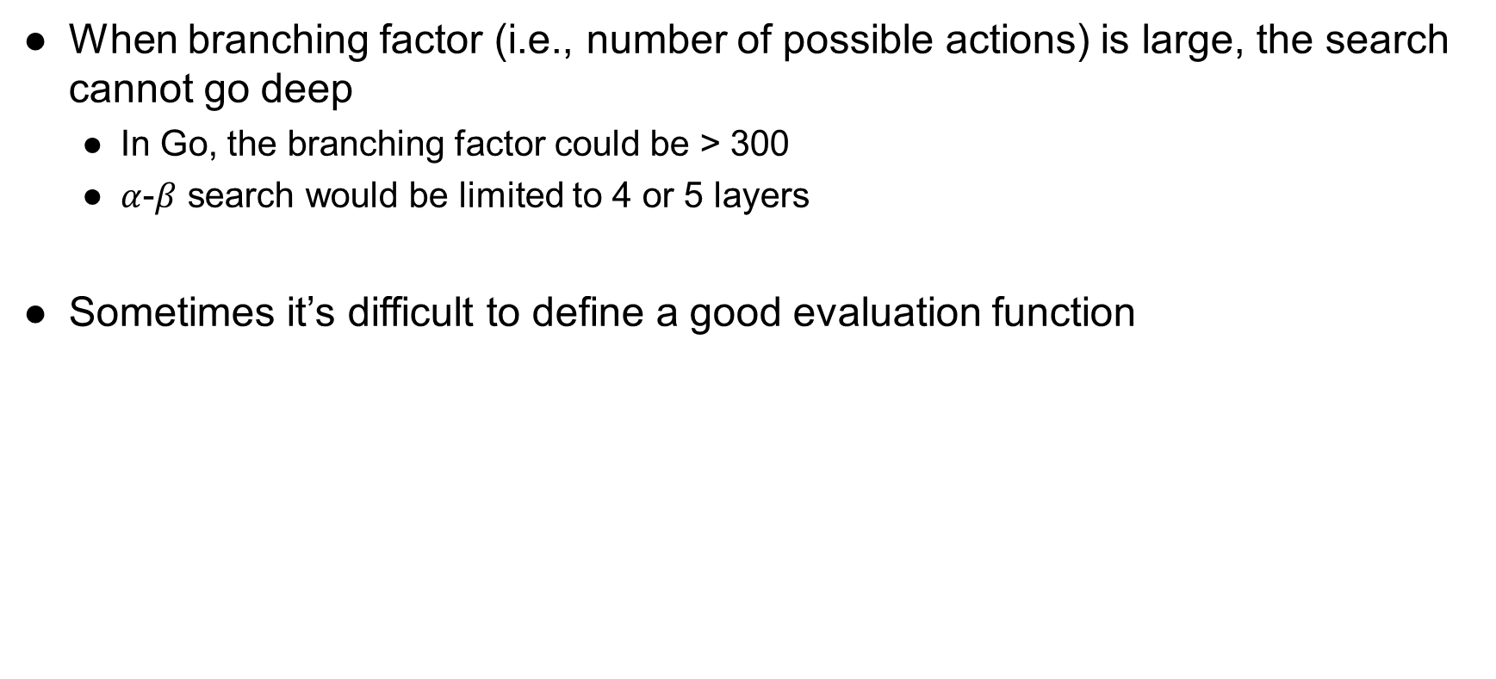
Issues of the Search Methods We Introduced So Far
When branching factor (i.e., number of possible actions) is large, the search cannot go deep
In Go, the branching factor could be > 300
$α$-$β$ search would be limited to 4 or 5 layers
Sometimes it’s difficult to define a good evaluation function

Slide 56
Monte-Carlo Tree Search (MCTS)
Selective search
Do not try to explore all possible actions
Only explore parts of the tree that has more potential to improve for the root
Evaluation by rollouts
Play multiple games to termination from a state (using some rollout policy), and evaluate through win rate

Slide 57
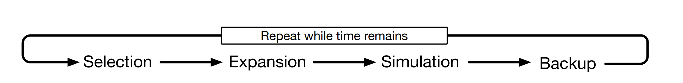
Monte-Carlo Tree Search (MCTS)

Slide 58
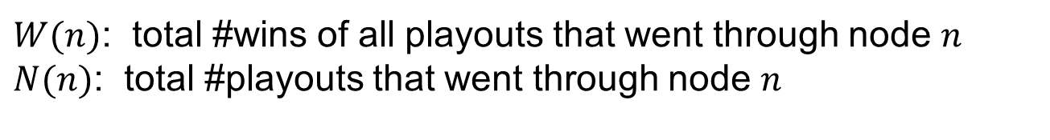
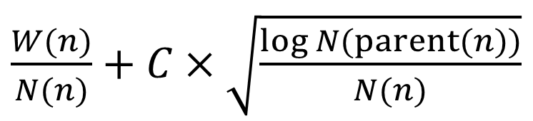
Monte-Carlo Tree Search (MCTS)
37/100
Selection
Starting from the root node, execute tree policy until reaching a leaf node
One effective tree policy is given by UCB1, which chooses an action based on
60/79
1/10
2/11
3/26
16/53
6/6
3/4
27/35
10/18
0/3
0/3
$\frac{W(n)}{N(n)}+C×\sqrt{\frac{log N(parent(n))}{N(n)}}$
$W(n)$: total #wins of all playouts that went through node $n$
$N(n)$: total #playouts that went through node $n$

Slide 59
Monte-Carlo Tree Search (MCTS)
37/100
Expand
On some iterations, grow the search tree from selected leaf nodes by adding one or more child nodes
60/79
1/10
2/11
3/26
16/53
6/6
3/4
27/35
10/18
0/3
0/3
0/0

Slide 60
Monte-Carlo Tree Search (MCTS)
37/100
Simulation
From the selected or expanded node (if any), execute the rollout policy to the end of the game
Rollout policy
Could be heuristics, such as “consider capture moves” in chess
Could be learned through neural networks by self-play
60/79
1/10
2/11
3/26
16/53
6/6
3/4
27/35
10/18
0/3
0/3
0/0
Execute rollout policy
Black wins

Slide 61
Monte-Carlo Tree Search (MCTS)
37/101
Backup
Update the #wins and #playouts on nodes along the tree policy
61/80
1/10
2/11
3/26
16/54
6/6
3/4
28/36
10/18
0/3
0/3
0/1

Slide 62
Monte-Carlo Tree Search (MCTS)
Finally,
Choose the action from the root node that has the largest visit count.
Why not the action with the highest win rate?
After the opponent’s move, start the same procedure from the new state (can keep the statistics from the previous state)

Slide 63
Application of MCTS in AlphaGo and AlphaGo Zero
Check Section 16.6 of https://www.andrew.cmu.edu/course/10-703/textbook/BartoSutton.pdf

